Slide 1
Developing Infrastructure Code for CI and CD
Ravikanth Chaganti
@ravikanth
#psconfasia

Slide 2
AGENDA
Infrastructure as Code
Writing IaC
Summary

Slide 3

My Story!

Slide 4
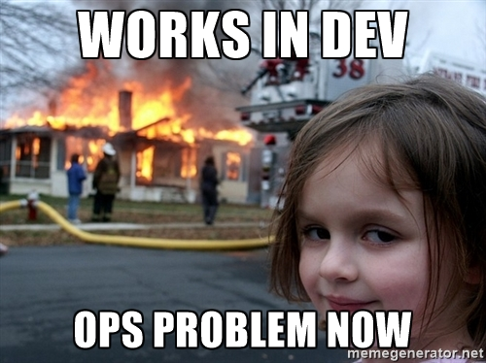
My Story!

Slide 5

My Story!

Slide 6
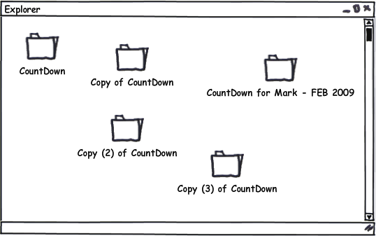
My Story!

Slide 7
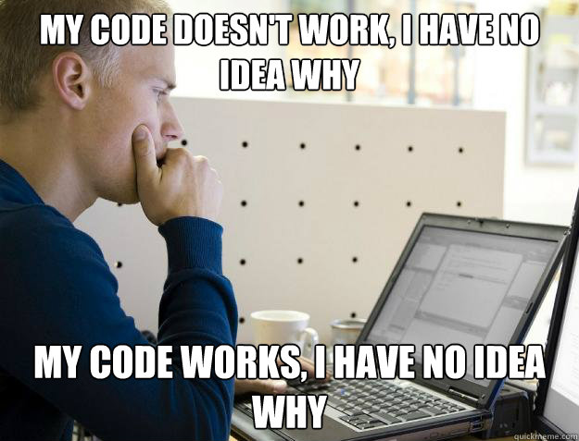
My Story!

Slide 8
Infrastructure As Code
Writing Code to Manage Configurations and Automate Provisioning of Infrastructure using Tools and Practices from Software Development

Slide 9




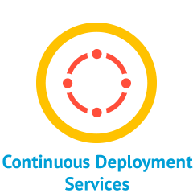

Infrastructure As Code
Reusable automation
Source Control
Unit Testing
Continuous Delivery / Deployment
Integration and Operations
Validation

Slide 10
Writing IaC – Make your code re-usable
Parameterize the scripts and configurations
Divide the scripts into re-usable modules
Adopt the infrastructure blueprints or patterns

Slide 11
Writing IaC – Make your code Idempotent
Start
Running the script should have the same impact irrespective of how many times you run it.
Perform changes only when needed
Configuration management tools use this method
TEST
True
False
SET
End

Slide 12
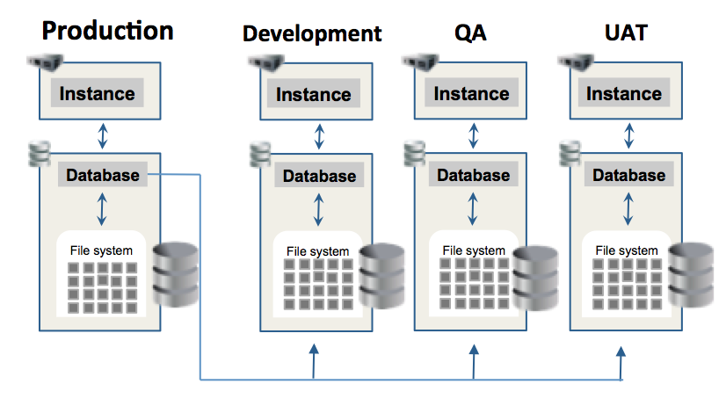
Writing IaC – Separate Structural and Environmental Configuration
Image Source: http://datavirtualizer.com/delphix/delphix-oracle-12c/

Slide 13
Writing IaC – Document what you write!
Always code as if the guy who ends up maintaining your code will be a violent psychopath who knows where you live - John F. Woods
Source: https://groups.google.com/forum/#!msg/comp.lang.c++/rYCO5yn4lXw/oITtSkZOtoUJ

Slide 14
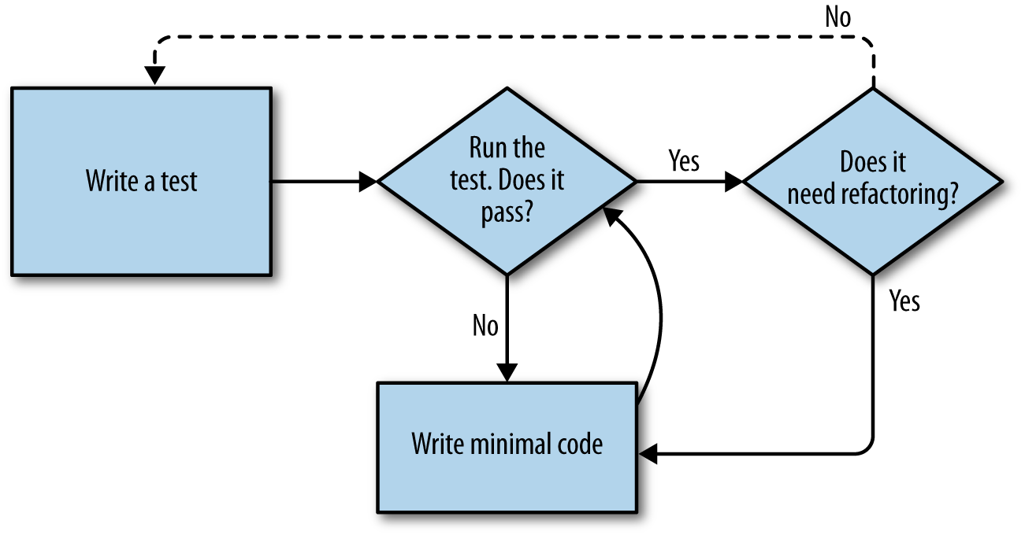
Writing IaC – Unit / Integration Testing (TDD)
Image Source: http://www.obeythetestinggoat.com/book/chapter_04.html

Slide 15
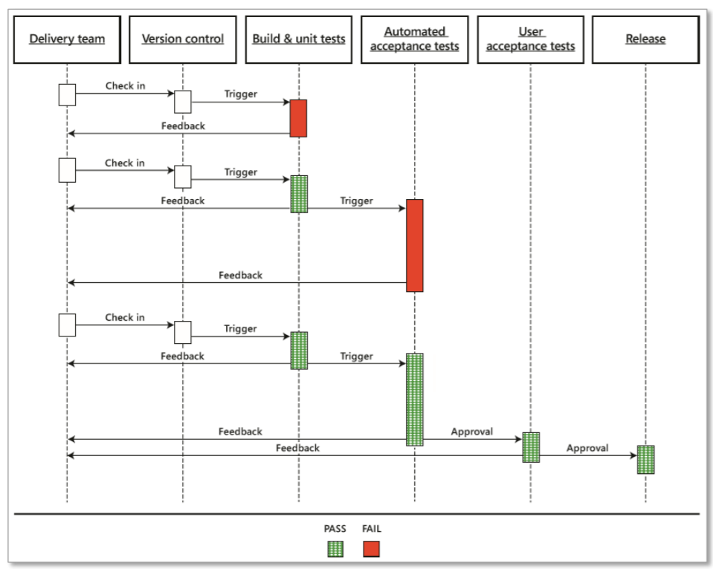
Writing IaC – Deploy a release pipeline

Slide 16
Summary
IaC brings a new level of agility into IT
There are several tools that enable you do write infrastructure code
Release pipeline is important for success

Slide 17
PS Conference Sessions ….
Pre-conference Workshop
DevOps on AWS with PowerShell
Day 1
Cross-Platform testing with Chef and DSC on Azure
Day 2
Using AWS CloudFormation and PowerShell DSC
Dev -> QA -> Production using PowerShell & Visual Studio Team Services
Infrastructure Release Pipeline : Lessons Learned
Field Experience: Implementing the Microsoft Release Pipeline
Centralised PS Repo Server
Puppet: Configuration Management and DSC
Writing Professional Help for PowerShell Modules

